Slide 1
GAS (Gait Analysis System)
Making physical therapy easier for everyone
TEAM MEMBERS:
ZOE FOWLER, HOLIDAY GARRISON, RYAN HOPSON, MUAMMAR SAEED, CHRIS SLAGELL

Slide 2


Team Members
Zoe Fowler (Team Lead & Hardware Design – Ankle Bracelet Subsystem)
Chris Slagell (Hardware Design – Belt Subsystem and Subsystem Connection)

Slide 3

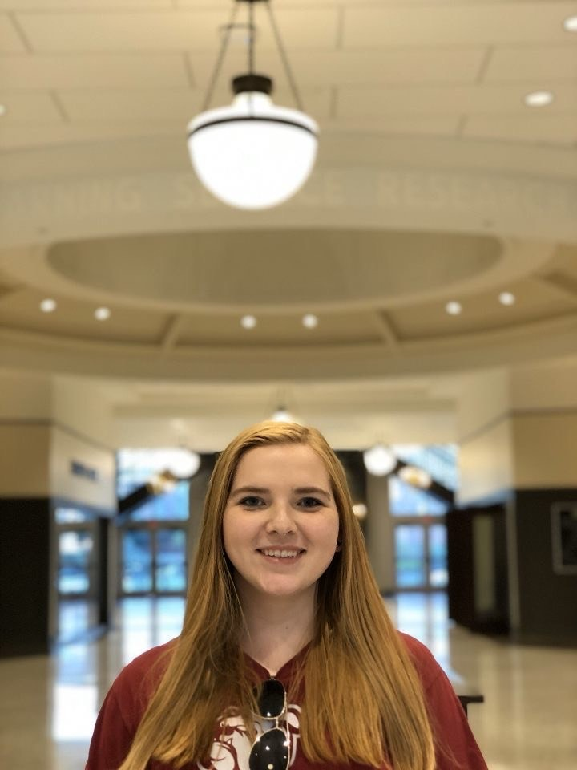

Team Members
Muammar Saeed (Software Design – Smartphone Application)
Holiday Garrison
(Software Design – Sensor Detection)
Ryan Hopson
(Software Design – Data Processing)

Slide 4

Faculty Advisor
Dr. James E. Fowler
William L. Giles Distinguished Professor
Professor, Mississippi State University
Department of Electrical and Computer Engineering
B.S., M.S., Ph.D., Ohio State University

Slide 5

External Advisor
Tracy Blackstock
Physical Therapist, Sta-Home Health & Hospice
B.S., University of Iowa
M.P.T., University of Miami
D.P.T., A. T. Still University

Slide 6

Problem and Solution

Slide 7

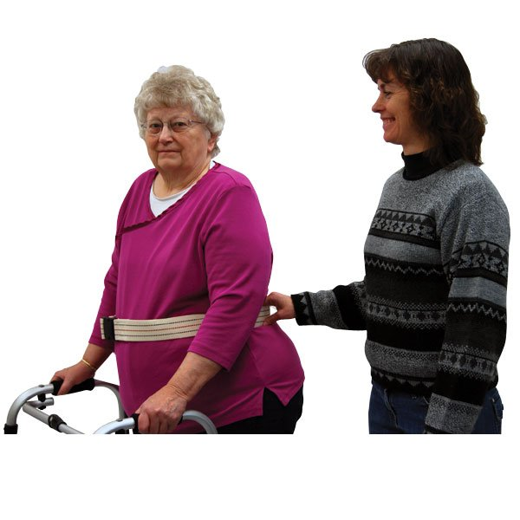
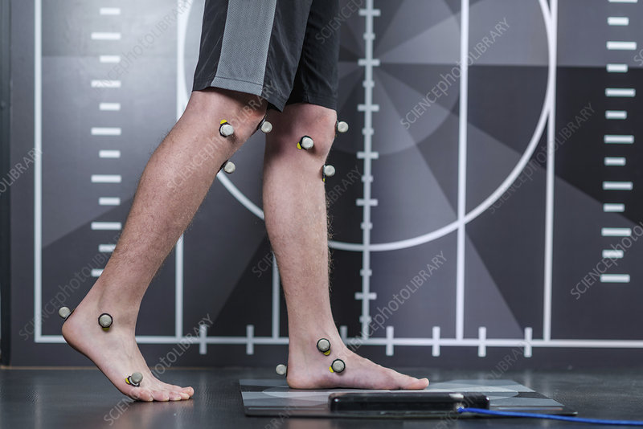
Problem
Gait analysis is an assessment performed by physical therapists
Important for correcting injuries
Pre-existing methods are either expensive or do not record data
Difficult to see whether patient is improving
[1]
[2]

Slide 8

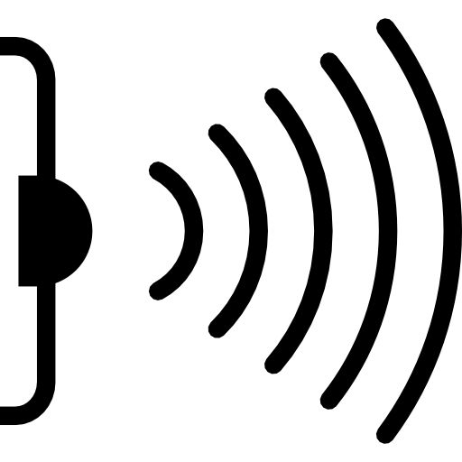
Solution
GAS is used for gait performance analysis
Comprised of a comfortable belt and two snug ankle bracelets
Uses sensors to record important walking data from the user
Physical therapists can connect to GAS via USB with no required training
[3]
[4]

Slide 9
Outline
Progress & Conclusion
Constraints
Approach

Slide 10

Constraints

Slide 11
Technical Constraints
Name | Description
Battery Life | ≥1 hour
Waist/Ankle Size [6], [7] | Waist: 91 – 111 cm Ankle: 19.7 - 24 cm
Measurement Frequency [8] | ≥ 115 measurements per minute
Measurement Accuracy | ±5%
Memory Storage | ≥1 hour's worth of data

Slide 12
Practical Constraints
Type | Name | Description
Manufacturing | Weight | ≤2.3 kg
Economic | Price | ~$150
Cultural | Clothing | Worn over a variety of clothing
Health & Safety | Safety | Wires will not be tripped over
Cultural | Data | Multiple types of data are measured

Slide 13
Engineering Standards
Specific Standard | Standard Document | Specification / Application
USB 2.0 [9] | Universal Serial Bus Revision 2.0 Specification | USB 2.0 allows connection to the physical therapist’s app.
IEEE 82079 Part 1 [10] | IEEE 82079 | An instruction manual is provided so that the product is safely used.
IEC 60228 - AWG [11] | IEC 60228 | The wires used in the construction of GAS must be an appropriate size according to AWG.

Slide 14
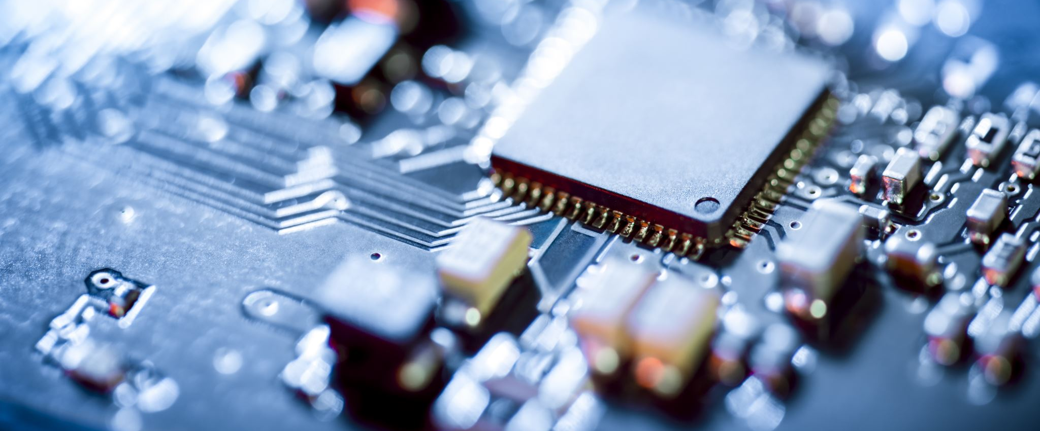
Approach

Slide 15
Hardware Overview

Slide 16
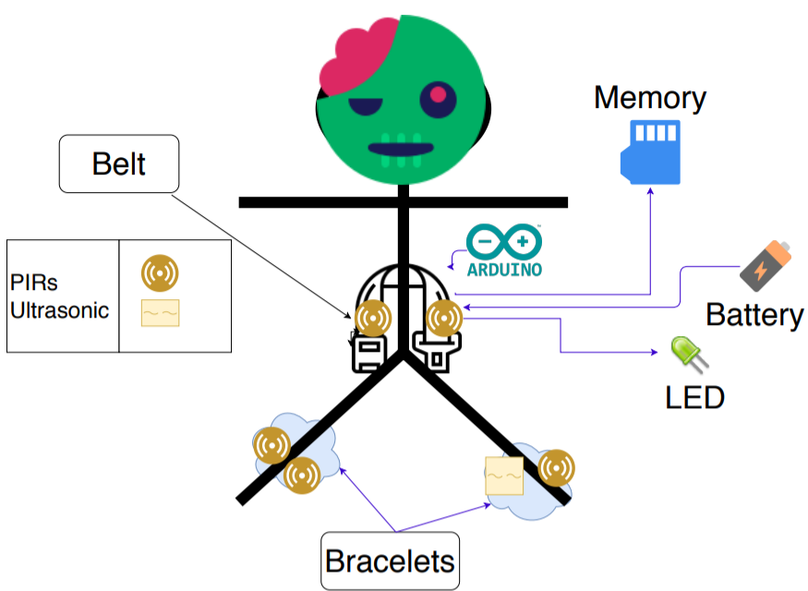

Slide 17
Microcontroller
Microcontroller | Cost | Number of Digital Pins | Number of Analog Pins | Includes 5-V and 3.3-V Regulators
Requirements | < $40 | At least 5 | At least 1 | Yes
Arduino Uno Rev3 [12] | $23.00 | 14 | 6 | Yes
Arduino Mega 2560 [13] | $40.30 | 54 | 16 | Yes
Arduino Due [14] | $40.30 | 54 | 12 | Yes

Slide 18
Motion Sensors
Product | Cost | Range | Measuring Angle (°) | Delay Time
Requirements | < $20 | < 10 m | < 120 | < 0.6 sec
HC-SR501 [15] | $2.60 | Up to 3 m to 7 m | 110 | 3 sec to 5 min
SEN-13968 [16] | $15.95 | Up to 2 m to 5 m | 110 | 0.4 sec to 7.5 sec
AMN34111 [17] | $14.68 | Up to 10 m | 110 | 30 sec

Slide 19
Distance Sensor
Product | Cost | Range | Measuring Angle (°) | Time for One Measurement (ms) | Time between Measurements (ms) | Output
Requirements | < $10 | 2 cm – 100 cm | As small as possible | < 400 | < 400 | Analog
HC-SR04 [18] | $3.95 | 2 cm – 400 cm | 30 | 0.01 | 60 | Analog
PING))) #28015 [19] | $29.99 | 2 cm – 300 cm | N/A | 0.05 | 0.2 | Analog
US-100 [20] | $6.95 | 2 cm – 450 cm | < 15 | 0.01 | 60 | Analog

Slide 20
Subsystem Connection
Wired Connection |  | Wireless Bluetooth Connection
Pros | Cons | Pros | Cons
Less Expensive and Lightweight | Trip Hazard – Can Be Avoided By Using a Knee Brace | No Trip Hazard | More Expensive and Heavy
Less Current Consumption/ Longer Battery Life | -- | -- | More Current Consumption/ Shorter Battery Life
1 Piece – Harder to Lose | -- | -- | 3 Pieces – Easier to Lose

Slide 21
Memory Chip
Memory Chip | Cost | Storage Space | Current Draw | Supply Voltage | Type of Chip
Requirements | < $20 | > 55 kB | < 10 mA | 3.3 V or 5 V | Flash Memory
CAT25512 [21] | $0.60 | 64 kB | 3 mA | 1.8 V to 5.5 V | EEPROM
LE25S81A [22] | $0.59 | 1000 kB | 5 mA | 1.65 V to 1.95 V | Flash Memory
Arduino MKR MEM Shield [23] | $19.50 | 2000 kB | 4 mA | 2.7 V to 3.6 V | Flash Memory

Slide 22
Battery
Product | Cost | Volume (cm³) | Weight (g) | Output Voltage | Capacity (mAh) | Chemical Makeup | Rechargeable
Requirements | < $10 | < 100 | < 454 | 7 to 12 | > 134 | -- | --
6LR61 [24] | $3.36 | 21.0 | 46.0 | 9 | 580 | ZnMnO2 | No
PP45 [25] | $44.99 | 258.75 | 579 | 12 | 3000 | NiMH | Yes
DL-5 [26] | $3.49 | 43.26 | 54.4 | 6.0 | 2200 | ZnMnO2 | No

Slide 23
Software Overview

Slide 24
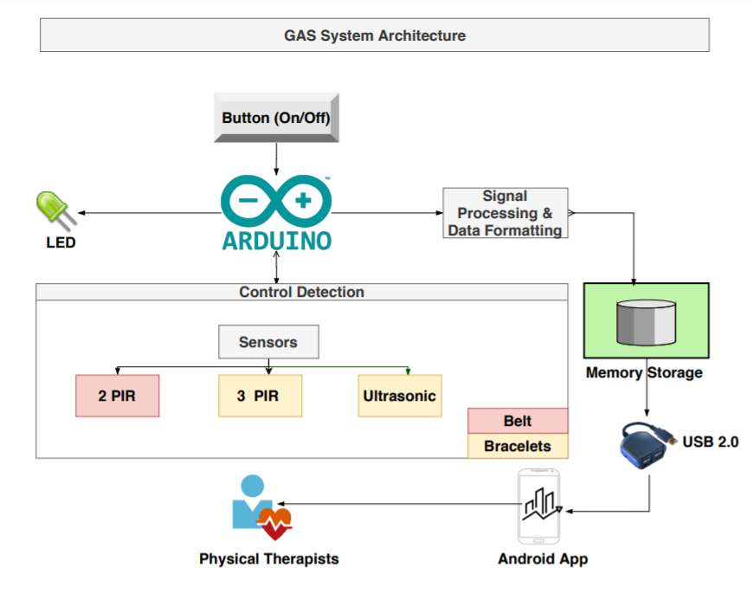

Slide 25
Control Detection
Belt's power button is pressed.
Initialize ultrasonic and PIR sensors. Flash LED slowly once if sensors are not responding.
PIR sensor detects motion and informs ultrasonic sensor when to take distance measurement
If the battery is low, LED should blink twice every two seconds.
If USB is connected, deactivate all sensors.
PIR and ultrasonic sensor record raw sensor data.
If memory is full, blink five times every two seconds.
Package data and transfer once the Android app is ready.
If power button is pressed to turn off, save data in memory.
Display the package of data by timestamps in the app.

Slide 26
Data Processing
Type of Sensors | PIR | Ultrasonic
Returned Sensor Reading | Pin Voltage | Distance and Sound
Implementation | Increment arm-sway counter Raise flag if nearby objects detected Triggers ultrasonic sensors | Upon parallel position: 1. Start or reset timers for step time 2. Increment number of steps 3. Width b/w users' feet
Calculated | Avg. time taken b/w arm swings Ratio of position to arms relative to the feet | Length of walking session in minutes Avg. width of users' feet Avg. time taken for each step

Slide 27
Memory Storage
Arduino formats data for app transfer
Data is stored until transferred to app
LED indicates when memory is full

Slide 28
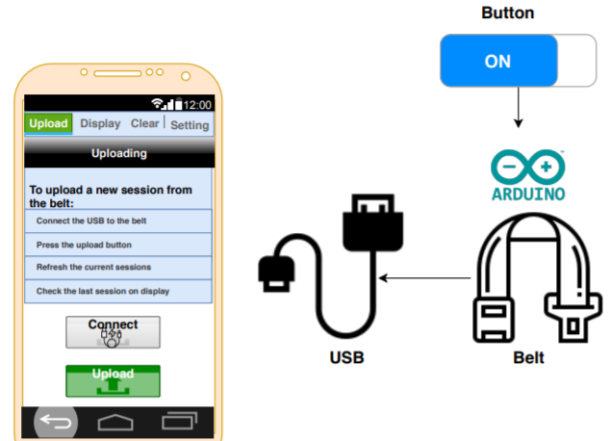
Data Transferring
Connecting the USB cable
Turning the belt on
Pressing the upload button
Refresh

Slide 29
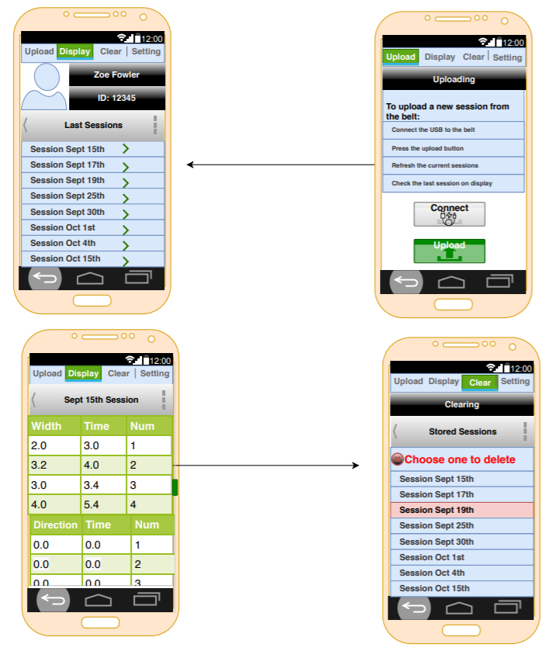
Smartphone Application

Slide 30
Smartphone Application

Slide 31

Progress and Conclusions

Slide 32
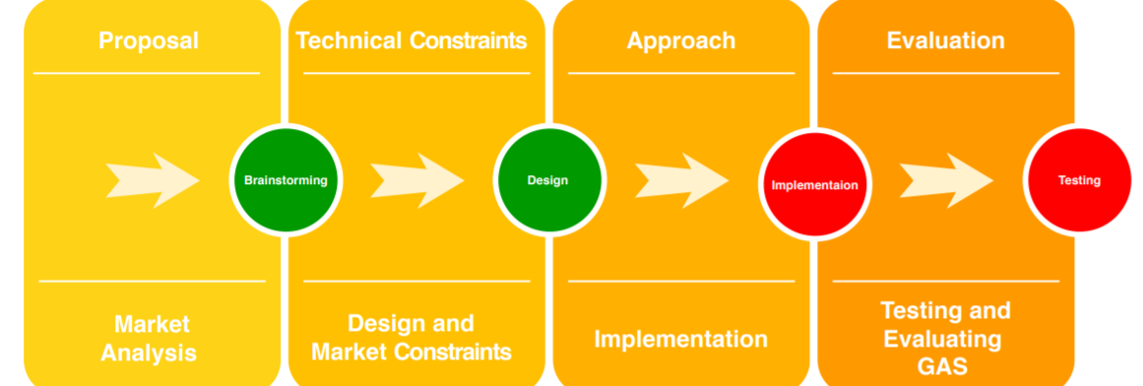
Progress

Slide 33
Conclusion
GAS provides a way to record gait-related data without a physical therapist
The device makes the jobs of outpatient physical therapists easier
Users' physical therapy experiences are more helpful and productive

Slide 34
References
[1] “MRI Non-Magnetic Transfer / Gait Belt.” Available: https://www.ocelco.com/store/pc/MRI-Non-Magnetic-Transfer-Gait-Belt-p13096.htm [Accessed 08/30/2020].
[2] “Markers for gait analysis.” Available: https://www.sciencephoto.com/media/1014006/view/markers-for-gait-analysis [Accessed 08/30/2020].
[3] "Woman is Walking." Available: https://creazilla.com/nodes/22293-woman-is-walking-for-exercise-clipart [Accessed 08/30/2020].
[4] "Infrared Sensor Symbol." Available: https://favpng.com/png_view/license-infrared-symbol-sensor-png/c6Bm1yxd [Accessed 08/30/2020].
[5] “FastStats - Body Measurements,” Centers for Disease Control and Prevention, 2020. [Online]. Available: https://www.cdc.gov/nchs/fastats/body-measurements.htm [Accessed 08-Sept-2020].
[6] “MIL-STD-1472D,” Abbott Aerospace Technical Library, 1989. [Online] https://www.abbottaerospace.com/wpdm-package/mil-std-1472d-human-engineering-design-criteria-for-military-systems-equipment-and-facilities/ [Accessed 07-Sept- 2020].
[7] T. Blackstock, Private Communication, August 2020.
[8] “Universal Serial Bus Specification”, 2000 [Online]. Available: http://sdpha2.ucsd.edu/Lab_Equip_Manuals/usb_20.pdf [Accessed: 06-Sept-2020].
[9] “82079-1-2019 - IEEE/IEC International Standard for Preparation of information for use (instructions for use) of products - Part 1: Principles and general requirements,” IEEE 82079 Part 1 – IEEE SA. [Online]. Available: https://standards.ieee.org/standard/82079-1-2019.html. [Accessed: 07-Sept-2020].
[10] “International Standard IEC 60228,” 2004 [Online]. Available: https://webstore.iec.ch/preview/info_iec60228%7Bed3.0%7Den_d.pdf. [Accessed: 07-Sept-2020].
[11] “Arduino Uno Rev3,” Arduino | store.arduino.cc, 2020. [Online]. Available: https://store.arduino.cc/usa-uno-rev3 [Accessed 16-Sept-2020].
[12] “Arduino Mega 2560 Rev3,” Arduino | store.arduino.cc, 2020. [Online]. Available: https://store.arduino.cc/usa/mega-2560-r3 [Accessed 28-Sept-2020].

Slide 35
References
[13] "Arduino Due," Arduino | store.arduino.cc, 2020. [Online]. Available: https://store.arduino.cc/usa/due [Accessed 28-Sept-2020].
[14] “HC-SR501 Passive Infrared (PIR) Motion Sensor,” [Online]. Available: https://www.epitran.it/ebayDrive/datasheet/44.pdf [Accessed 17-Sept-2020].
[15] “SparkFun OpenPIR,” Sparkfun Electronics. [Online]. Available: https://media.digikey.com/pdf/Data%20Sheets/Sparkfun%20PDFs/SEN%E2%80%9013968_Web.pdf [Accessed 17-Sept-2020].
[16] “Passive infrared human detection sensor with built-in amp,” Panasonic. [Online]. Available: https://www.alliedelec.com/m/d/9b0187f5be4c4127a102d8868f3222c2.pdf [Accessed 17-Sept-2020].
[17] “Ultrasonic Ranging Module HC-SR04,” ElecFreaks. [Online]. Available: https://cdn.sparkfun.com/datasheets/Sensors/Proximity/HCSR04.pdf [Accessed 16-Sept-2020].
[18] “PING))) Ultrasonic Distance Sensor (#28015),” Parallax. [Online]. Available: http://www.farnell.com/datasheets/2622313.pdf [Accessed 16-Sept-2020].
[19] “US-100 Ultrasonic Distance Sensor – 3V or 5V Logic,” Adafruit. [Online]. Available: https://media.digikey.com/pdf/Data%20Sheets/Adafruit%20PDFs/4019_Web.pdf [Accessed: 16-Sept-2020].
[20] "CAT25512" OnSemi. [Online]. Available: https://www.onsemi.com/pub/Collateral/CAT25512-D.PDF [Accessed: 28-Sept-2020].
[21] "LE25S81A" OnSemi. [Online]. Available: https://www.onsemi.com/pub/Collateral/LE25S81A-D.PDF [Accessed: 28-Sept-2020].
[22] "Arduino MKR MEM Shield," Arduino | store.arduino.cc, 2020. [Online]. Available: https://store.arduino.cc/usa/mkr-mem-shield [Accessed: 28-Sept-2020].
[23] "6LR61," Energizer. [Online]. Available: https://data.energizer.com/PDFs/Ind-6LR61PL_EU.pdf [Accessed: 27-Sept-2020].
[24] “12V 3,000 mAh NiMH Battery Pack, PP45,” Studica. [Online]. Available: https://www.studica.com/us/en/Studica-Robotics/12v-3-000-mah-nimh-battery-pack-pp45_1/70018_1.html?ex_ref=google_feed&gclid=EAIaIQobChMIzZDt8dDx6wIVF0qGCh0B3AZ4EAQYAiABEgJHv_D_BwE [Accessed: 17-Sept-2020]
[25] “DL-5 Battery,” Complete Battery Source. [Online]. Available: https://www.completebatterysource.com/dl-5-battery.php?gclid=EAIaIQobChMI_YXw7NHx6wIVGEmGCh1lVgdXEAQYAiABEgJYtvD_BwE [Accessed: 17-Sept-2020].
[26] "Computer with Positive Graph Clipart." Available: https://www.pinclipart.com/pindetail/ihboJxb_computer-with-positive-graph-clipart/ [Accessed 08/30/2020].

Slide 36


Appendix A: Target Audience
Outpatient therapy, home health, and inpatient rehabilitation
Sensors measure average step time, average step width, average arm swing time, and relative position of arms and legs
Useful for determining if patient is a fall risk
Presents averages in a graph as they change over time
Other information reported in tables
[26]

